Slide 1
Building Elastic SaaS Applications with Azure SQL DB
Shawn Weisfeld
shawn@shawnweisfeld.com
http://www.ShawnWeisfeld.com

Slide 2
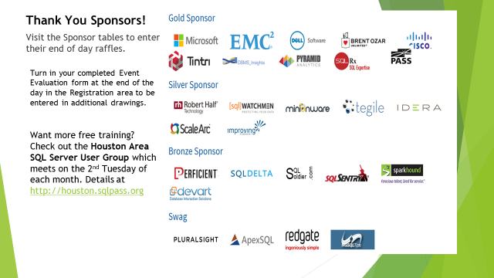

Slide 3







About Me
Founder of UserGroup.tv
Technical Evangelist at Microsoft

Slide 4


Watch User Group presentations for FREE online!
All the topics you care about
Including:
Agile
C#
Entity Framework
HTML5
MVC
Silverlight
XAML
jQuery
and Much More!
Miss a User Group meeting?
Forget something that you learned?
Want to see content from a User Group not in your area?
Want to share with a buddy?
We know you cannot make it to every User Group meeting,
that is why we post them online for you!
We now have over 500 presentations online
That is over 100 GB of video
New Content added all the time!
Presentations from the thought leaders on the topic.
For new content announcements
@UserGroupTV
http://www.UserGroup.tv

Slide 5
Want to go to VS Live in Boston?
June 13-16
Got to http://usergroup.tv and click on “Win a Ticket” for details.
Register for VSLive Austin for 4 days of #dotNET training, May 16-19! Save $500 w/code AUUG03: http://bit.ly/AUUG03Home

Slide 6
Session Objectives And Takeaways
Session Objective(s):
Learn how to easily scale SaaS applications to thousands of customers/tenants and databases
Understand how to leverage Elastic Database features for scalable SaaS applications
Single-database per tenant is a compelling application pattern for SaaS applications
Azure SQL DB makes it easy to build applications following the single-database per tenant pattern

Slide 7
Topics
Azure SQL Database from 40,000 feet
SaaS applications on SQL Database
Developing and managing large groups of databases
Handling unpredictable workloads
Querying across groups of databases

Slide 8
SQL Options in Azure
IaaS
Virtual machines, you manage just like you do today
PaaS
Managed Services, where Microsoft does most of the work for you

Slide 9

Azure SQL Database
Fully managed SQL database service so you can focus on your business
Built for SaaS and Enterprise applications
Predictable performance & Pricing
Elastic database pool for unpredictable SaaS workloads
99.99% availability built-in
Geo-replication and restore services for data protection
Secure and compliant for your sensitive data
Fully compatible with SQL Server 2014 databases

Slide 10
Database Service Tiers
Basic
Standard
Premium
Intended Use
Light transactional workloads
Go-to option for most business applications
High throughput and business-critical databases
Performance
•
••
•••
Workload Elasticity
Isolated databases and elastic database pools
Programming Surface
Fully compatible with SQL Server 2014 databases
Availability
99.99%*
*The 99.99% availability SLA does not apply to Web and Business editions, which continue to be supported at 99.9% availability.

Slide 11
Data-intensive SaaS applications
SaaS provider customer end-user
Data isolation, privacy, protection
Scaling to unlimited customers
Unpredictable usage

Slide 12
SaaS on Azure SQL Database
Database-per-customer model leverages SQL Database strengths
Database independence, isolation simplifies development and management
Security, auditing, monitoring
Lifecycle and capacity management
Oops recovery
Schema unchanged by scale
SQL Database tools and experiences
Cross-database query for reporting, integration
Multi-database job execution for maintenance
Visual Studio data tools, SSMS, Azure portal
Familiar programming experiences

Slide 13
Typical SaaS Application Architecture
Scalable cloud service, load balanced in normal use
Cloud Service
Catalog database holds mapping to customer databases
Catalog
Customer Catalog
Cust 1
Cust 2
Cust 3
Cust N
Scale out data tier by adding additional customer databases
Customer Databases

Slide 14
Challenge: Data-Dependent Routing
1. End users connect to cloud service
Cloud Service
2. Cloud service looks up customer in catalog
3. Cloud service routes directly to customer database
Catalog
Customer Catalog
Cust 1
Cust 2
Cust 3
Cust N
Customer Databases

Slide 15
Elastic database development and management
Multi-database management
Define the set of databases that is the data tier of your application
Map customers (tenants) to databases
Data-dependent routing
Route incoming requests to the correct database
Ensure correct routing if databases move
Cache routing information
Elastic Database Tooling
Generally Available
Easily accessible download from NuGet

Slide 16
Challenge: Predictable Performance
Cloud Service
Catalog
Customer Catalog
Cust 1
Cust 2
Cust 3
Cust N
Customer Databases

Slide 17
Challenge: Predictable Performance Levels
Basic, Standard, and Premium provide increasing performance levels
Scale via portal, PS, REST APIs, or T-SQL to reflect actual or anticipated demand
Database remains online while scaling
Hourly billing provides cost efficiency
P11
P6
P4
P2
P1
S3
S2
S0
S1
B
DTUs
5
10
20
50
100
125
250
500
1000
1750

Slide 18
T-SQL:
ALTER DATABASE JacarandaJazzCub
MODIFY (edition='Standard')
PowerShell:
Set-AzureSqlDatabase -ResourceGroupName wtpdemo
-ServerName wtpcustomers-sc
-DatabaseName JacarandaJazzClub -RequestedServiceObjectiveName Standard;
REST API:
PUT
https://management.azure.com/subscriptions/{subscriptionId}/resourceGroups/{resourceGroupName}/providers/microsoft.sql/servers/{serverName}/databases/{databaseName}?api-version=2014-04-01
Request body
{
"location": “<location>”,
"properties": { "requestedServiceObjectiveId":“<serviceObjectiveID>“ }
}
https://msdn.microsoft.com/en-us/library/azure/mt163571.aspx

Slide 19
Scale databases to match customer needs
Cloud Service
Catalog
Customer Catalog
Cust 2
Cust 1
Cust 1
Cust 2
Cust 3
Cust N
Cust 3
Customer Databases

Slide 20
Challenge: Unpredictable capacity needs, large scale
Cloud Service
Catalog
Customer Catalog
Cust 1
Cust 2
Cust 3
Cust 4
Cust 5
Cust 6
Cust 7
Cust 9
Cust 9
Cus
Cus
Cust N
Cust 1
Cust 2
Cust 3
Cust 4
Cust 5
Cust 6
Cust 7
Cust 8
Customer Databases

Slide 21


Slide 22
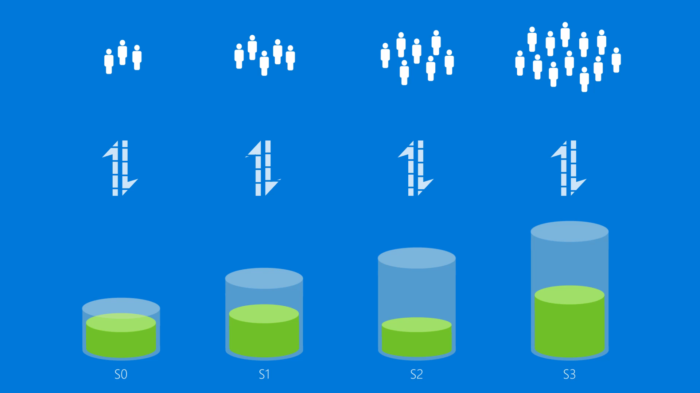

Slide 24
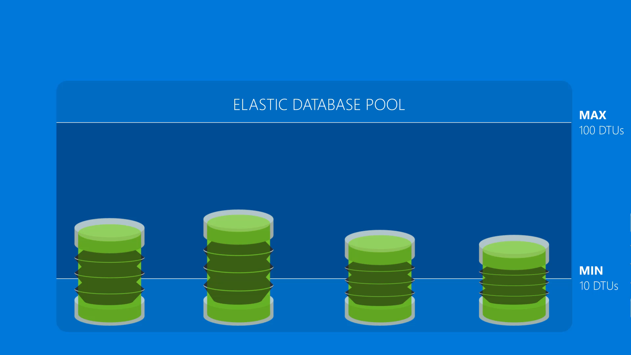

Slide 25
Elastic Database Pools
Elastic databases, Elastic database pools
Pooled resources leveraged by many databases
Standard elastic pool provides 100-1200 eDTUs for up to 400 databases
Elastic Standard databases can burst up to 100 eDTUs
Create/configure pool via portal, PowerShell, REST APIs
Move databases in/out using portal, PowerShell, REST APIs, T-SQL
Databases remain online throughout
Monitoring and alerting is available on both pool and databases
eDTUs
100
400
800
1200

Slide 26
Elastic databases grouped into one or more pools
Cloud Service
Catalog
Customer Catalog
Cust 1
Cust 2
Cust 3
Cust 4
Cust 5
Cust 6
Cust 7
Cust 9
Cust 9
Cus
Cus
Cust N
Cust 1
Cust 2
Cust 3
Cust 4
Cust 5
Cust 6
Cust 7
Cust 8
Customer Databases

Slide 27
Challenge: Handling occasional intense workloads
Cloud Service
Catalog
Customer Catalog
Cust 1
Cust 2
Cust 3
Cust 4
Cust 5
Cust 6
Cust 7
Cust 9
Cust 9
Cust 2
Cust 3
Cust 4
Cus
Cus
Cust N
Cust 1
Cust 2
Cust 3
Cust 4
Cust 5
Cust 6
Cust 7
Cust 8
Customer Databases

Slide 28






Challenge: Querying across database sets
Cloud Service
PowerBI
Catalog
Customer Catalog
Elastic
Query
Cust 1
Cust 2
Cust 3
Cust N
Customer Databases

Slide 29
Querying across many databases
Connect to a single SQL DB database using familiar SQL DB connection strings
Simple setup with T-SQL DDL
Transparent querying of many databases from a single database
Familiar programming experience with T-SQL, ADO. NET Linq, EF etc.
Use familiar development and BI tools to query across many databases
Designed for interactive querying
Elastic Database Query
More Info: https://azure.microsoft.com/en-us/documentation/articles/sql-database-elastic-query-overview/

Slide 30
Challenge: Managing many databases
Cloud Service
Catalog
Customer Catalog
T-SQL
Cust 1
Cust 2
Cust 3
Cust N
Customer Databases

Slide 31
Managing many databases
Elastic Database Jobs
Apply changes or administrative operations to many databases
Use familiar T-SQL scripts to define jobs
Built-in automatic retries in case of transient failures
Tightly integrated with elastic pools in the new Azure Portal
Designed for batch processing

Slide 32

Azure SQL DB & Elastic Database
DB
DB
DB
Global database-as-a-service
Predictable workloads
Unpredictable workloads at massive scale for SaaS applications
Easy development, simple self-service management
Powerful cross-database querying and management
DB
DB

Slide 33
The Transient Fault Handling Application Block
Transient faults are errors that occur because of some temporary condition such as network connectivity issues or service unavailability. Typically, if you retry the operation that resulted in a transient error a short time later, you find that the error has disappeared.
https://msdn.microsoft.com/en-us/library/hh680934(v=pandp.50).aspx

Slide 34
Call to Action
Start building SaaS applications in Azure today
Explore Azure SQL DB and its new elastic capabilities designed for SaaS

Slide 35
Session Objectives And Takeaways
Session Objective(s):
Learn how to easily scale SaaS applications to thousands to customer
Understand how to leverage Elastic Database features for SaaS applications
Single-database per tenant is a compelling application pattern for SaaS applications
Azure SQL DB provides compelling support for the single-database per tenant pattern

Slide 36
More Info:
Building Multitenant SaaS Applications with Tenant Isolation and Unlimited Scale on Azure SQL Database
https://channel9.msdn.com/events/Build/2016/P522
Torsten Grabs –
Create a new elastic database pool
http://azure.microsoft.com/en-us/documentation/articles/sql-database-elastic-pool-portal/
Documentation Map **
http://azure.microsoft.com/en-us/documentation/articles/sql-database-elastic-scale-documentation-map/

Slide 37
Demo
DIY Demo
Captain Smack Down

Slide 38
Q&A
?
Questions…

Slide 39
Thank you! Your Feedback is Important
Rate My Talk & Download Slides!
http://bit.ly/RateShawnsTalk
Contact Information
Email: shawn@shawnweisfeld.com
Blog: http://www.shawnweisfeld.com
Twitter: @shawnweisfeld

Slide 40

© 2016 Microsoft Corporation. All rights reserved. Microsoft, Windows, and other product names are or may be registered trademarks and/or trademarks in the U.S. and/or other countries.
The information herein is for informational purposes only and represents the current view of Microsoft Corporation as of the date of this presentation. Because Microsoft must respond to changing market conditions, it should not be interpreted to be a commitment on the part of Microsoft, and Microsoft cannot guarantee the accuracy of any information provided after the date of this presentation. MICROSOFT MAKES NO WARRANTIES, EXPRESS, IMPLIED OR STATUTORY, AS TO THE INFORMATION IN THIS PRESENTATION.

